Slide 1
Client Side Optimization
July 11, 2017

Slide 2
Agenda
What is a client?
How web works?
Why optimization?
Optimizing intermediary
Practical

Slide 3
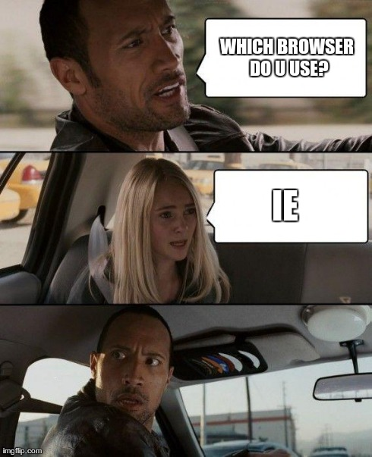
What is a client?
Web is evolving over the time.
Multiple types of clients.
Desktop
iOS
Android
Notes:
Discuss about multiple types of clients and session’s main focus.

Slide 4
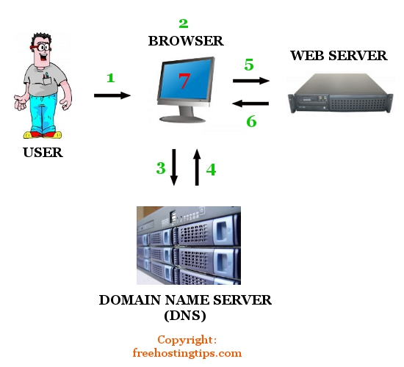
How web works?
Browser makes a request with a domain name.
Domain name is translated to server’s IP address through DNS server.
Request is made through HTTP protocol.
Server responds with relevant data.
Notes:
Discussion about the working of web, essentially the transit phase of the requests.
DNS - http://igoro.com/archive/what-really-happens-when-you-navigate-to-a-url/
Browser -> OS -> router -> ISP -> recursive search
Side Note - how to solve single ip mapping bottleneck lb, round robin multiple ips

Slide 5
Quick look into Devtools
Let's take an example of http://facebook.com
Notes:
http://facebook.com
Look at example visit a site study the request response headers
Look at devtools
status codes response etc, Look at
dive deep later into Expires cache control Etag etc headers
starts rendering before entire response is recvd, make internal call css, image scripts, ajax
Talk a bit about proxies like fiddler, charles, chrome extensions
Server Side - request handlers, webservers

Slide 6
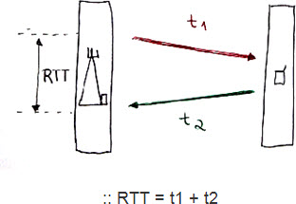
How web works?
HTTP requests are expensive.
Speed is inversely proportional to number of requests.
Every request has a cost called RTT.
Notes:
Discussion about the working of web, essentially the transit phase of the requests.

Slide 7
Why optimization?
Users are impatient.
Dropoffs will lead to increase in churn rate.
Every missed view could possibly be missed revenue.
Notes:
Discussion about optimizing transit phase

Slide 8
Optimizing transit phase
Possible candidates?
Number of requests.
Payload being sent.
Network latency.
Notes:
Discussion about optimizing transit phase.

Slide 9

Number of requests
HOW???
Reduce number of assets to request. (CSS, JS, Images)
Concat Scripts & Styles if possible.
Use image sprites or image maps.
Plan your initial payload.
Notes:
Discussion about optimizing transit phase.
Number of requests
Why are they important.
Image maps css sprites
Inline images (increase in size of main content page)
Seperate scripts combined scripts
Number of parallel connections per host browser. 6 for chrome 8 for ff
Advantages parallel connections
Disadvantages cookies, dns etc
http://stevesouders.com/hpws/rules.php

Slide 10
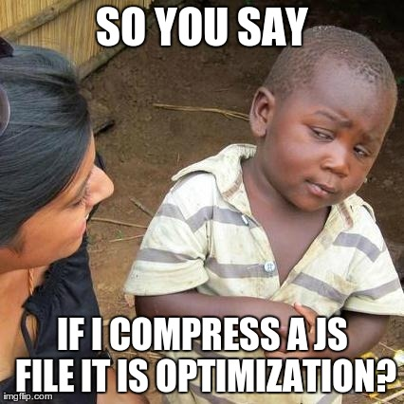
Number of requests
Notes:
Talk about effect on cache, when is combining useful when not.
Single small page,
Multiple page side common js
Feature wise js split.
Cachebility importance

Slide 11
Number of requests
Not Really...
Notes:
Discussion about optimizing transit phase

Slide 12
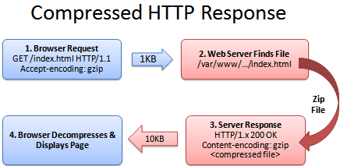
2. Payload being sent
Gzipping
Accept-encoding: gzip, deflate
Zip the content before sending it to the client.
Client will handle decoding.
Notes:
Discussion about optimizing transit phase.
Gzip at server, cdn, etc
Example - http://stevesouders.com/hpws/gzip-html.html

Slide 13
3. Network Latency
CDN? - Content Delivery Network
Distributed across the globe.
Cache and deliver from the geographically nearest node.
Caching is done on the basis of resource url and host.
Notes:
Discussion about optimizing transit phase
Sample without cdn - http://1.find.keywordblocks.com/nmedianet.js?cid=8CUR5RQW9
With cdn - http://contextual.media.net/nmedianet.js?cid=8CUR5RQW9

Slide 14

3. Network Latency
Is CDN just enough?
Uniqueness is inversely proportional to hits.
A miss = Client < = > CDN < = > Origin = More awesomeness :D
Notes:
Discussion about optimizing transit phase
If time persists talk about advanced stuff such as ESI (scripting on CDN layer for dynamic content) overview why is it needed.

Slide 15
3. Network Latency
Client Side Caching
Browsers can understand headers and cache stuff locally.
How?
Cache-Control: max-age=1209599
Expires: Thu, 31 Jul 2014 01:43:15 GMT
LAST-MODIFIED & ETag
Notes:
Discussion about optimizing transit phase
https://developers.google.com/web/fundamentals/performance/optimizing-content-efficiency/http-caching
Cache control expires strong
Last modified etag weak
Etag- > If-None-Match
Cache Control
No-cache - possible round trip no download based on etag
"No-store" - nothing always new
Public private

Slide 16
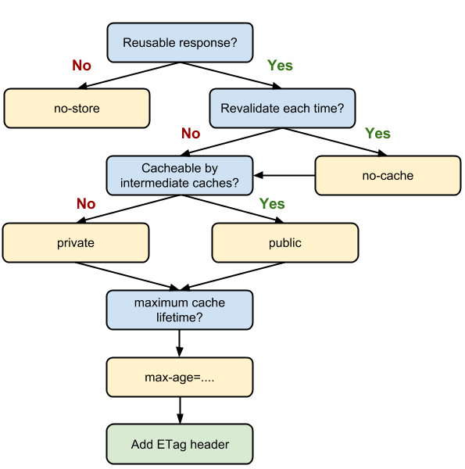

Slide 17

3. Network Latency
Notes:
Discussion about optimizing transit phase

Slide 18
3. Network Latency
Rules for caching
Set a reasonable expires limit.
Use headers like if-modified-since or e-tags
Use cache-primer logic.
Notes:
Discussion about optimizing transit phase

Slide 19
Questions
How to break cache at different layers?
When to avoid cache?
Caching strategies for various resources - css scripts images fonts
Notes:
Browser - hash signaturer versions
Cdn Server change in path , ignore query strings etc. CDN Interfaces

Slide 20
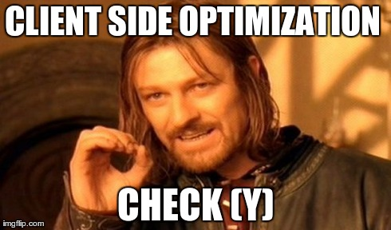
Optimizing transit phase
Is this the end?
Notes:
Discussion about optimizing transit phase

Slide 21

Optimizing transit phase

Slide 22
Optimizing rendering
Sync/Inline Scripts Block
They block rendering.
In few browsers, like IE, even downloading of other resources are blocked.
Any errors in synchronously loaded scripts will abort rendering.
<script src=”jquery.js”></script> [sync external script]
or
document.write(“<scr” + “ipt src=’jquery.js’></scr” + “ipt>”);
Or
<script> var test = 1; </script> [sync inline script]

Slide 23
Optimizing rendering
Load scripts at the bottom/onLoad
Let the browser do first paint before adding all the magics.
Will keep users notified that something is happening.
Makes more sense because JS can start interacting with DOM right away.

Slide 24
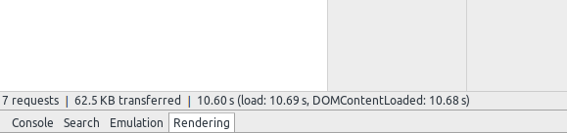
Optimizing rendering
Problem 2
Problem 1

Slide 25
Optimizing rendering
DOMContentLoaded
The DOMContentLoaded event is fired when the document has been completely loaded and parsed, without waiting for stylesheets, images, and subframes to finish loading.
Where are scripts?
and yeah you got it :)
Scripts block DOMContentLoaded Event

Slide 26
Optimizing rendering
How to get away?
1. Load Scripts Asynchronously.
2. Don’t have <script> below a <link rel=’stylesheet’> Resource [Generally styles don’t block parsing]

Slide 27
Optimizing rendering
DOM
1. A Rendered tree of your HTML Layout.
2. Any updates in the tree might trigger a repaint or sometimes a reflow.

Slide 28
Optimizing rendering
Repaint
A repaint, or redraw, goes through all the elements and determines their visibility, colour, outline and other visual style properties, then it updates the relevant parts of the screen.
Reasons:
1. Changing visibility of an element.
2. Font or Background Colors.
3. Borders and Box Shadows.

Slide 29
Optimizing rendering
Reflow
A reflow computes the layout of the page. A reflow on an element recomputes the dimensions and position of the element, and it also triggers further reflows on that element’s children, ancestors and elements that appear after it in the DOM. Then it calls a final repaint. Reflowing is very expensive, but unfortunately it can be triggered easily.
Reasons:
1. Changing Font Size.
2. display:none
3. Adding new nodes to DOM.
4. Changing dimensions of a node or applying classNames.

Slide 30
Optimizing rendering
Reflow
A reflow computes the layout of the page. A reflow on an element recomputes the dimensions and position of the element, and it also triggers further reflows on that element’s children, ancestors and elements that appear after it in the DOM. Then it calls a final repaint. Reflowing is very expensive, but unfortunately it can be triggered easily.
Reasons:
1. Changing Font Size.
2. display:none
3. Adding new nodes to DOM.
4. Changing dimensions of a node or applying classNames.

Slide 31
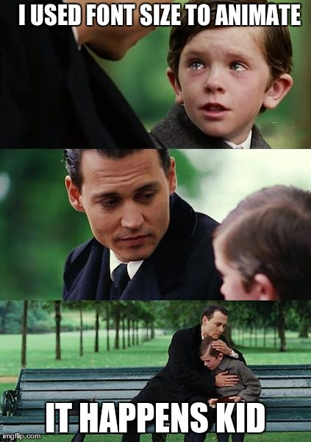
Optimizing rendering

Slide 32
Optimizing rendering
How to optimize?
Prefer CSS Class switching.
Don’t go deep into the woods.
Take it out and play with it.
Make sure the node is ready to be appended.
Delegate Events.
Throttle Events when needed.
Use Scaled Images.
Handle events with care.

Slide 33
Optimizing rendering
Short and Sweet HTML
Don’t use table based layout.
Keep reasonable depth and always update the least possible element.

Slide 34
Optimizing rendering
DOM
Minimize CSS rules, and remove unused CSS rules.
If you make complex rendering changes such as animations, do so out of the flow. Use position-absolute or position-fixed to accomplish this.
Avoid unnecessary complex CSS selectors - descendant selectors in particular - which require more CPU power to do selector matching.

Slide 35
Optimizing Rendering
DOM
Minimize CSS rules, and remove unused CSS rules.
If you make complex rendering changes such as animations, do so out of the flow. Use position-absolute or position-fixed to accomplish this.
Avoid unnecessary complex CSS selectors - descendant selectors in particular - which require more CPU power to do selector matching.

Slide 36
Optimizing Rendering
Optimizing jQuery
1. Go right to left [Descend from ID] and optimize selectors.
2. Cache results.
3. Use on() not click().
4. Use HTML5 to increase tag uniqueness.
5. Use append style tag instead of css() on demand.

Slide 37
What we do?
1. Akamai [cdn] + Varnish [Web accelerator].
2. Appropriate Cache headers.
3. Compression using YUI + unify scripts from serving end.
4. Load ads in non blocking mode.
5. Very minimal dns lookups.
6. DNS Caching.
7. Gzipping.
8. Device Targeting + GEO Target being in CDN
+ Write Good Code ;)

Slide 38
Tools?
Chrome
Firefox
Y!Slow
WebPage Test

Slide 39
Tools?
Require.js
AMD?
Common.js
jQuery AMD
r.js
An APP Example

Slide 40

Tools?
Gulp (the streaming build tool)

Slide 41

Client Side Optimization

Slide 42
Practical
Notes:
Discussion about optimizing transit phase

